Slide 1


PLEDGE TO PROGRESS Sustainability Hackathon
Sponsored By
Your Team Name : “Digital Artists”
Your team bio :
Date : 22 May, 2023
Rahul Dogra
Veena Viswanathan
Rahul Kadgavkar
Koushik Karan
Amit Nilajkar
Electronics & IOT Engineer
Product Design Engineer
Cloud/IT Engineer
Analytics & Strategy Expert. Presentation Specialist
Software and Web Expert

Slide 2
Agenda
Visual Pollution
Introduction
Business Model
Solution
Vision & Mission
Problem Statement

Slide 3
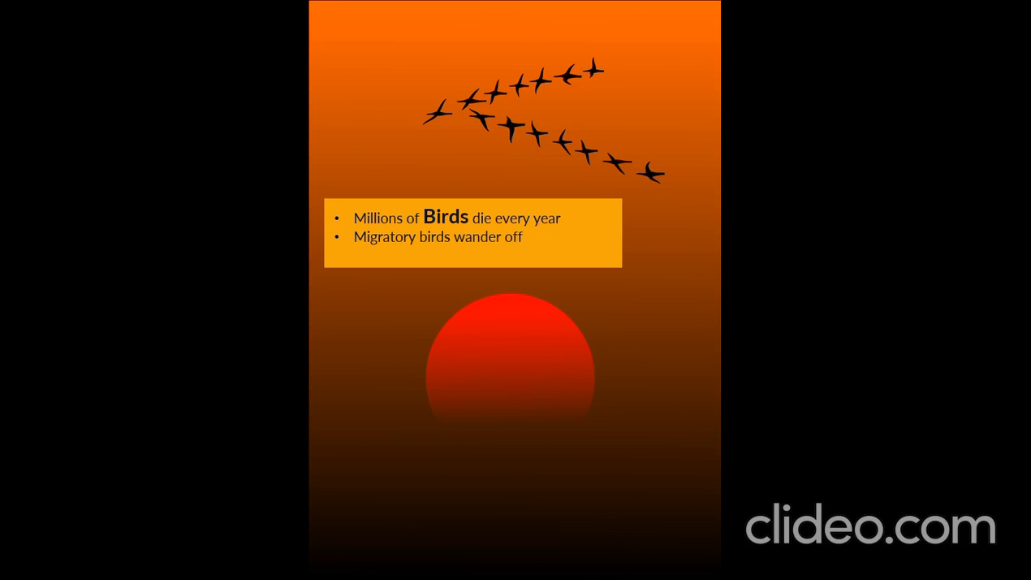

Slide 4
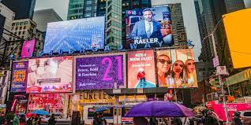
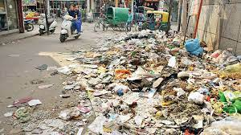
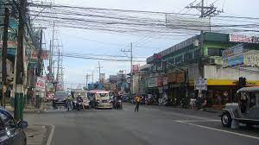
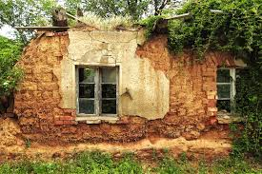
A new form of pollution identified….
Pollution that impairs one’s ability to enjoy a vista or view

Slide 5
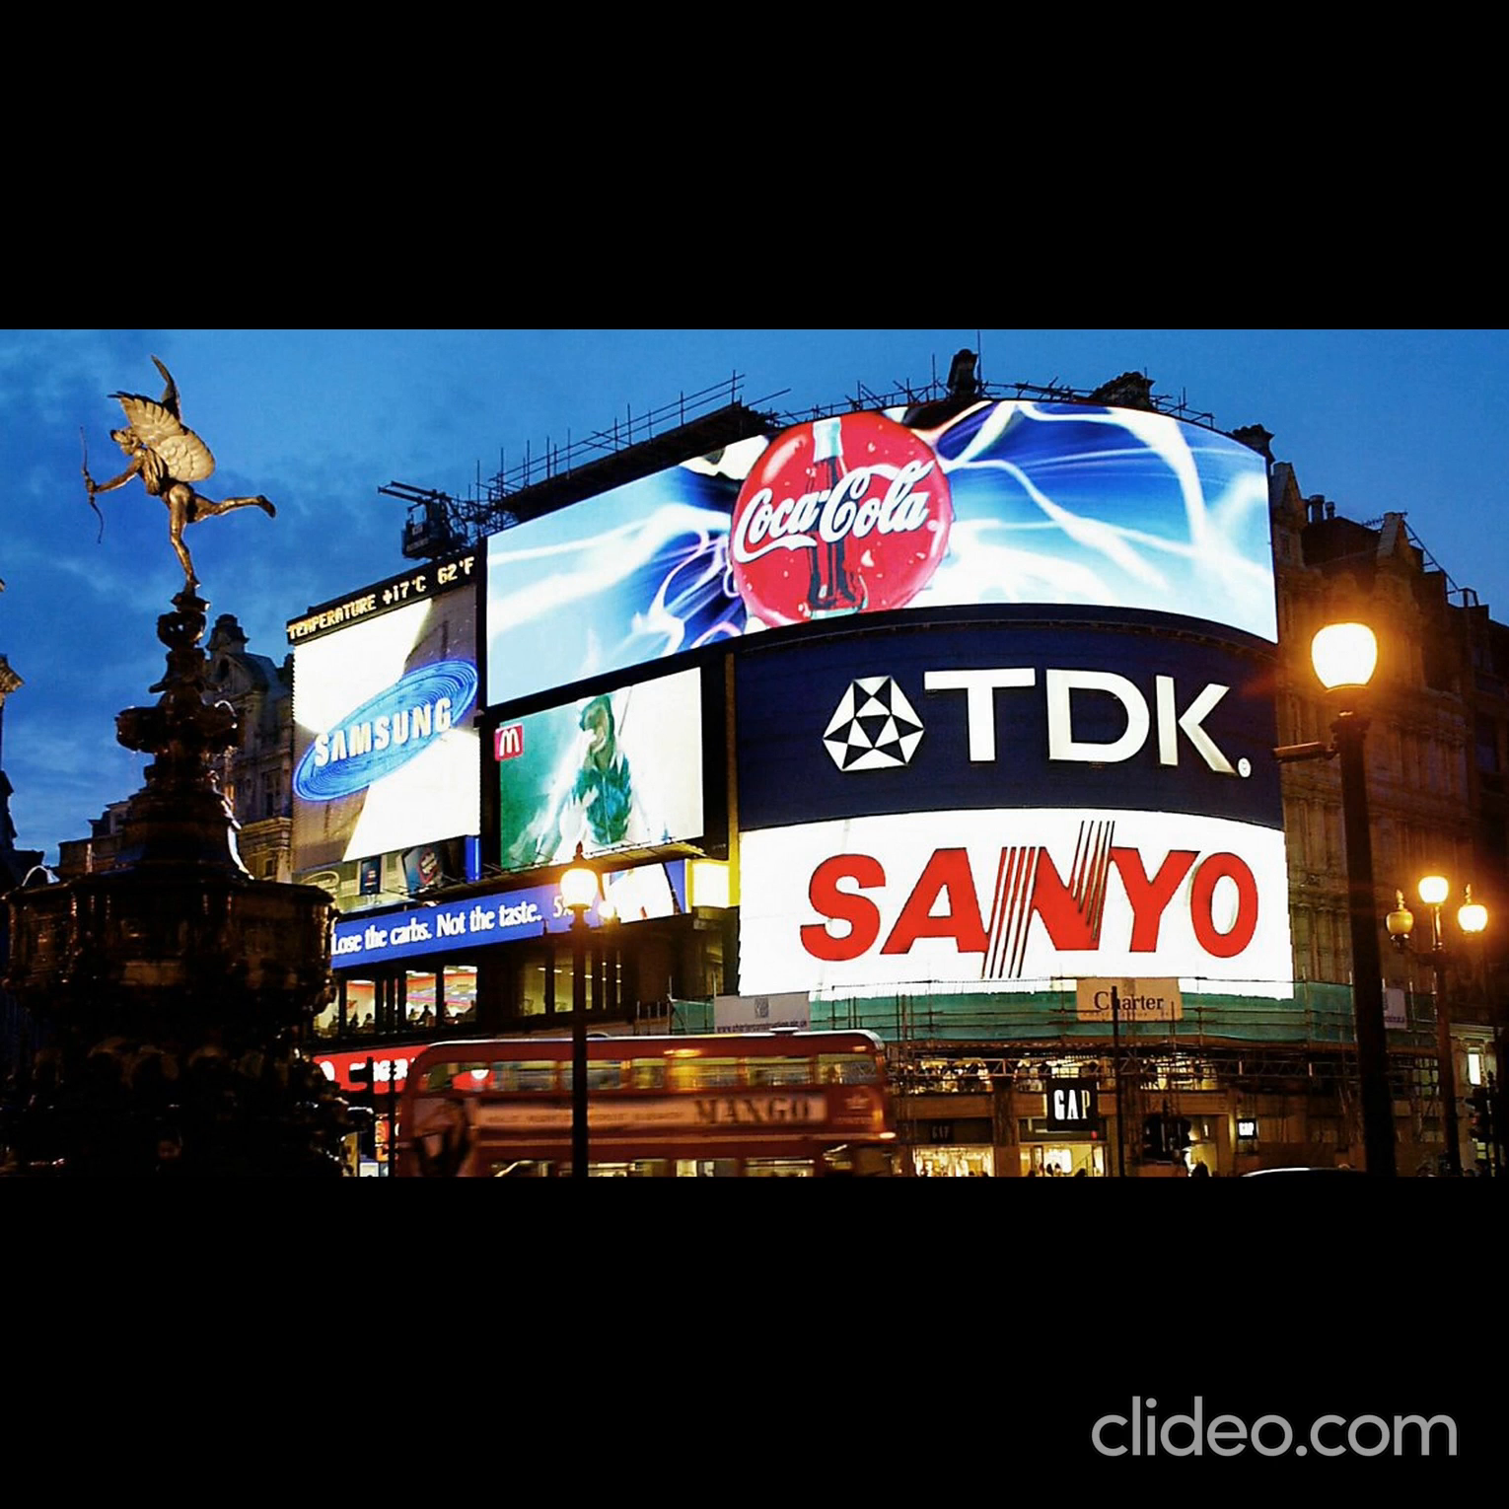
Visual Pollution – Out-of-Home Advertising

Slide 6
Visual Pollution Statistics
Highlights
24% is projected to increase to 36% by 2027
YoY Growth scripted by Retail, consumer services, real estate, e-commerce, automobile and telecom sectors
Boosted by a combination of E-Commerce & M-Commerce
https://www.mdpi.com/2071-1050/11/8/2211
http://www.in.kpmg.com/ficci-frames-16/ooh.html
https://www.statista.com/outlook/amo/advertising/out-of-home-advertising/india
VISUAL POLLUTION is One of the most serious and
was the most overlooked and is an unregulated pollution
in the world
– e4m statistics

Slide 7

Light as a source of Visual Pollution
Earth’s artificially lit outdoor area grew by 2.2% per year
https://www.science.org/doi/10.1126/sciadv.1701528
Artificial Lights increase air pollution by suppressing a naturally occurring radical called nitrate that cleans the air at night, slowing down cleansing process by 7%
Currently, more than 80% of the world's population is estimated to live under a “lit sky”
Visual Pollution also indirectly affects the quality of water and hence leads to water pollution
Visual Pollution is more poisonous than any other pollution because it kills the soul – Friedensreich Hundertwasser

Slide 8





Problem Statement and Solution
Reality
Consequence
Stakeholders
Congestion of a zone manifests into
Eye exhaustion, distraction, disorientation, and other psychological and emotional disturbances in humans.
Disruption of critical behavior in wildlife resulting in impact on bio-diversity.
There is impact on biodiversity at multiple levels and they’re interconnected causing an impact on the ecosystem.
Visual Pollution is a serious issue
Proposal
Scope
Out of Home Advertising (OoH) such as billboards, hoardings seen on the streets.
Country – Start with India and Scale
Digital advertising in and on vehicles – public transportation and hired taxis
Develop an Eco-Friendly re-usable data based Smart alternative backed by the science of light to control the impact of visual pollution.

Slide 9
Mission and Vision
Our Vision is to create a visual pollution free environment to lead a healthy life in harmony with nature
VISION
Our Mission is to protect people, bio-diversity and the environment by developing and delivering smart, robust solutions that combine science, technology and data in a sustainable and profitable way
MISSION
SUSTAINABILITY
DO THE RIGHT THING
INNOVATION
VALUES

Slide 10

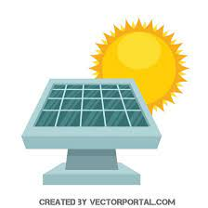

Smart Eco-Friendly Smart Visual Display in and on Vehicles
The automobile industry is now being shaped by electrically powered vehicles as it
Solar or other renewable/clean forms of energy combined with innovative display technology backed by the science of light can be adopted for utilizing the exterior surface and inside of private and public vehicles for targeting digital advertising.
This alternative option will help reduce/optimise visual pollution observed in traditional advertising methods, ensuring physical and mental health in human beings also lowering the impact on bio-diversity. This is a huge opportunity.
Reduces oil demand | Supporting sustainability
Minimizes greenhouse emissions | Resulting in environmental benefits
Lowers Life-Time Ownership Value | Saving cost
Visual Pollution is more poisonous than any other pollution because it kills the soul – Friedensreich Hundertwasser

Slide 11


Alternatives/Competitive products
There is a rise in entrepreneurial wave in the country. “Make in India” and “Startup India” initiatives are churning new ideas and products using novel techniques. Also, providing Near-Real-Time information/news has become the need of the hour. E-Governance could be supported through Information and Communication Technology (ICT) to communicate and relay important & emergency news. Sensors could be used to track the weather, wind speed and support optimized driving and relay local information.
Our solution is novel and the only other alternative/competition is Mobile Marketing. Since we’re talking about NRT possibilities this is also not a strong competition. Mobile ads reach the target audience only upon usage of the mobile device to browse or open a relevant app.
Marketing leaders are also constantly looking for ideas that would help them relay their communication in a more proactive and real-time manner.

Slide 12
Stakeholders & Challenges
Tie up with MaaS & Omni Channel marketing start-ups
Mobility-as-a-Service (MaaS) is an emerging trend. Omni-channel marketing supports precision targeting
It integrates transportation elements such as trip, capacity, route planning & payment services into a centralised platform
MaaS Mobility-Marketing ecosystem
Integrate Marketing Technology & Operations
Tie-up with the Government
Inbuild the capacity to integrate ICT for e-governance to facilitate speedy administration of information/localised information or content to the public.
Result: Personalised Transportation
Use Smart Infrastructure and inbuild Near-Real-Time capabilities through Artificial Intelligence data
Target the right customer with the right message at the right time
Result:
Additional revenue
Optimal driving decisions
Challenges: Network stability in the countryside

Slide 13
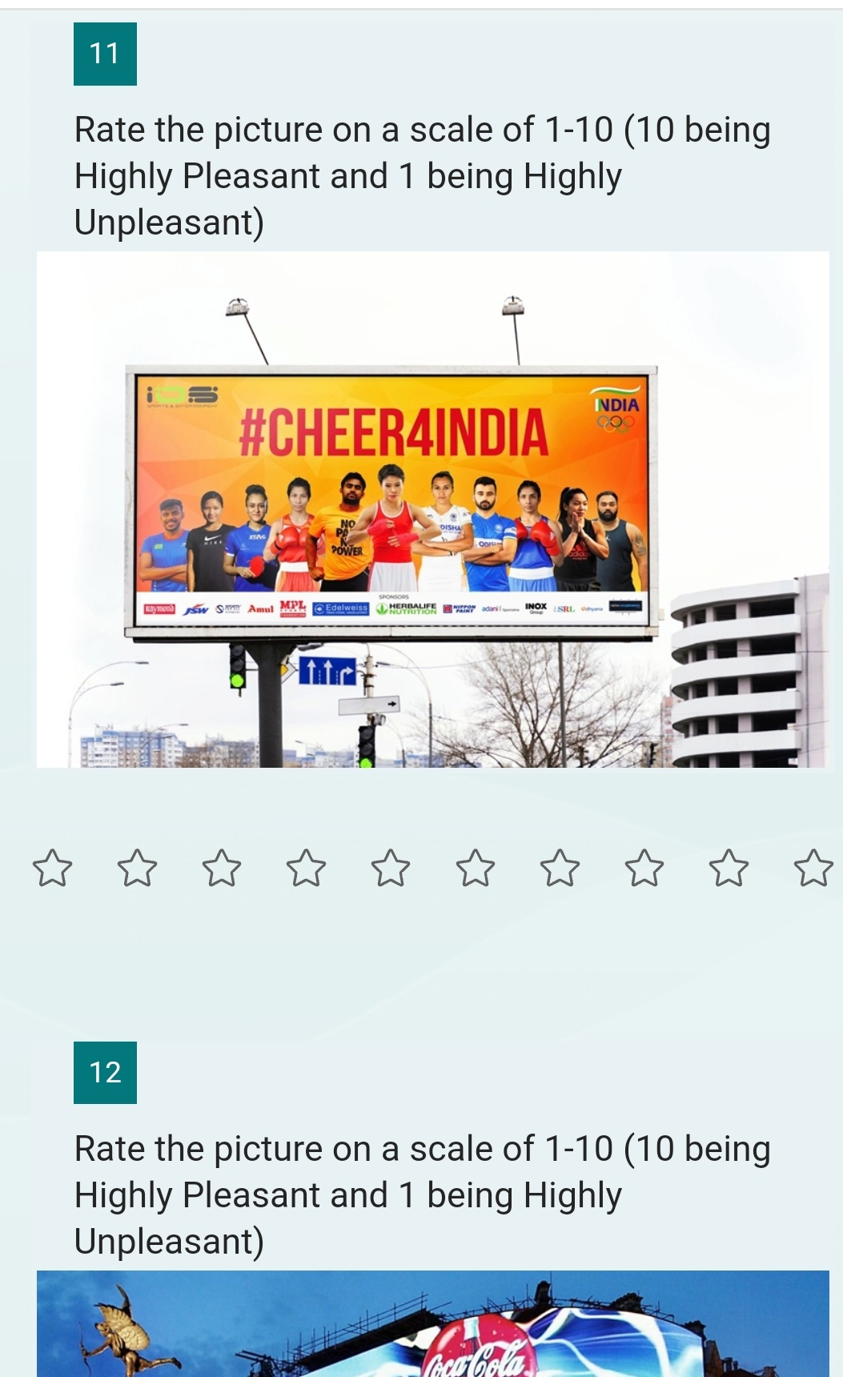
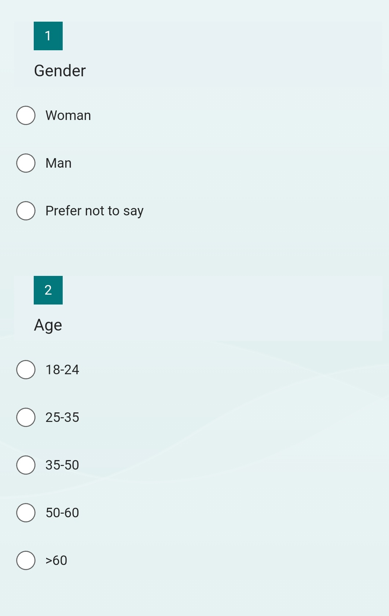
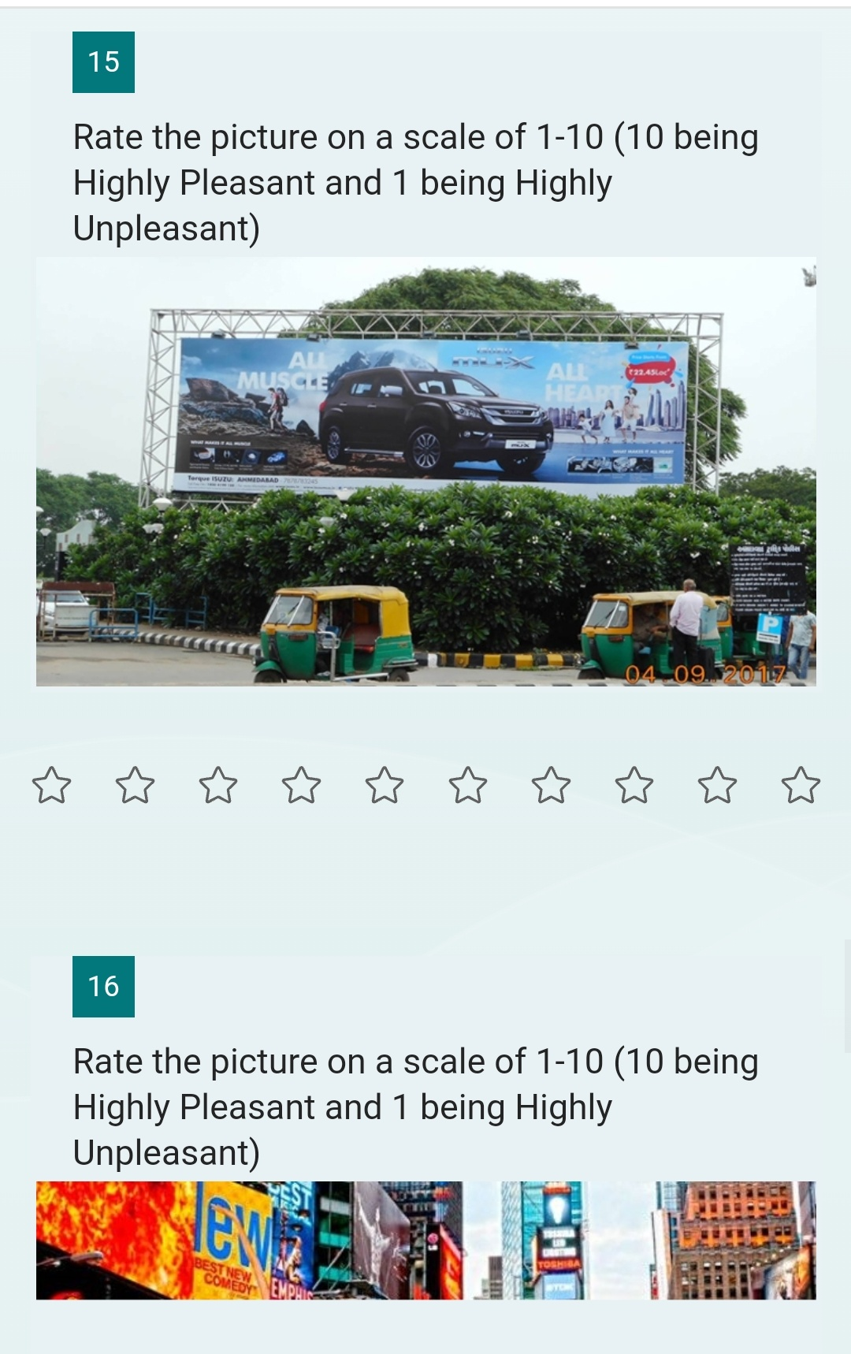
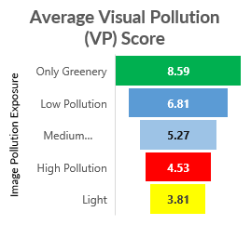
Visual Pollution Threshold Assessment - Survey Scorecard (Prototype)
Record and Report
Used a rapid method for visual pollution scoring using public surveys
The phenomenon of visual pollution is shaped by cultural aspects apart from the way the brain processes the information
INSIGHTS
Average tolerance of VP in Men is consistently higher than that of Women
In Low VP environment, having greenery in the scene of the pollution improved the scores
In High VP situations, presence or absence of greenery didn’t make a difference
Note: ANOVA conducted to test the null hypothesis in each of these cases
https://forms.office.com/r/uGiS2cxP19
Notes:
Visual Pollution Threshold (or) Permissible Visual Pollution Impact determination- Lesser the better

Slide 14
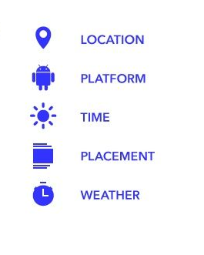
Transformative Sustainability Solution & Methodology
For Ads and Real-Time Info/News
Location based ICT (e-governance) & Marketing data
Wireless Module for Input
Raspberry Pi 4
Dev
Board
E-Ink Display (Smart Lighting) for output
IoT data/Data from MaaS
ADAS/Data from Sensors

Slide 15
















Architecture Reduce, Remove and Replace
Data Sources
1
Orchestration
2
3
AI based NRT
Output
4
Ingestion
Architecture
Omni-Channel Marketing
Microsoft
SQL Server
with SSMS
Data Storage
Analysis
Output
Weather/Wind speed, Pedestrian/Vehicle movement etc.
On Device Sensors Data
Survey to assess visual pollution
and identify areas to optimise
ADAS Data
E-ink Display
- Regulated &
Smart Lighting
Advanced Drive Assistance System (ADAS) data
Prep/Train
Authentication
Government
ICT Data
E-governance
data
Artificial Intelligence/
Machine Learning
Azure Sphere, Azure RTOS
MaaS
data
MaaS
Azure Networking Services
Azure Active Directory
*Microsoft Teams, Microsoft OneDrive and Microsoft Office for Project Management and virtual team collaboration.
*Microsoft Forms for the Survey
*GitHub for the repository

Slide 16
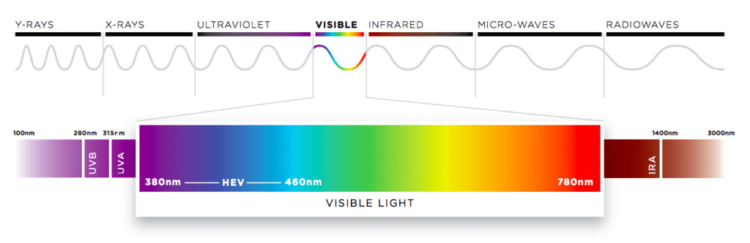
Displays backed by the science of light
wavelength
The longer the wave, lesser the energy it emits.
Blue light has short waves and hence intense energy.
Has harmful effects on the eyes.
E-ink display works by reflecting and absorbing light
Makes it fully readable even in direct sunlight, unlike LED displays.
Does not emit blue light, low eye strain.
Consume very less power, eco-friendly choice
Regulated Lighting Systems – Sensing a car or pedestrian and altering the light level from 10-100%
Smart Lighting – Sensing the time of the day and dimming the lights
Notes:
Lighting is dimmed to protect biodiversity and human eyes, the initial outlay is quickly recouped by the energy savings generated

Slide 17
Tools or resources
Hardware:
Used 2-wheeler or 4-wheeler
E-Ink display connected to Raspberry pi 4
Electronic systems, networking devices etc., with chip development and testing facility for low power consumption display technology.
Software and internet tools:
Azure IoT Hub and Azure Networking Services are required for enabling inter-connected device framework to be implemented in product design. Azure Sphere & Azure RTOS will be utilised for designing & testing
MS SQL will be used as backend customer database sever with Microsoft AI applications and SQL Studio (SSMS)
Microsoft OneDrive & Microsoft Azure for cloud implementation to make real time information available
Microsoft Teams & Office for virtual team collaboration & project management
Microsoft Github
Microsoft Forms for Survey

Slide 18

Challenges for Traditional OoH advertising industry
Awareness
Engagement
Discovery
Purchase
Retention
Our Solution
Static image
Cost
Reusability
Major Benefits
Data driven precise targeting
Reusable space (Sustainability)
More engaging due to dynamic content
Can dynamically change content
Cost effective
Adequacy
Limited Information
Precise Targeting Options
Fragmentation
Notes:
Fragmentation – Increasing choice and consumption of a range of media in terms of different channels such as web, mobile, also within channels eg. More tv channels, more social media options etc. The benefits of fragmentation overweigh the downsides because if we define our target audience properly we can have more relevant conversations with the right environment – less wastage, increase in effectiveness. Digital excellence.
Within in-vehicle ads, if a scan option is provided to engage, collect more data etc.
ROI justification?

Slide 19
Market Size
Total Available Market
https://www.statista.com/outlook/amo/advertising/out-of-home-advertising/traditional-out-of-home-advertising/india
https://smefutures.com/here-are-some-important-indian-advertising-statistics-for-2021/
Notes:
Ad spending in the Traditional OoH Advertising market is projected to reach US$0.42bn in 2023.
Ad spending is expected to show an annual growth rate (CAGR 2023-2027) of -0.47%, resulting in a projected market volume of US$0.41bn by 2027.
The average ad spending per capita in the Traditional OoH Advertising market is projected to amount to US$0.29 in 2023.
The Traditional Out-of-Home Advertising market refers to all revenues from advertising on traditional (physical) out-of-home media. The content in this market only refers to non-digital revenues. All figures refer to net values. Production costs, agency commissions, and discounts are excluded.
https://www.business-standard.com/article/companies/after-21-5-fall-in-2020-indian-ad-spends-to-rise-23-in-2021-report-121021600700_1.html
IN-SCOPE
Traditional billboards (bulletins, large banners, inflatable billboards)
Traditional street furniture (advertising columns)
Traditional transit & transportation (traditional indoor and outside advertising in and on vehicles used for public transportation)
Traditional place-based media (e.g. traditional ambient media at point of sale, posters in restrooms)

Slide 20
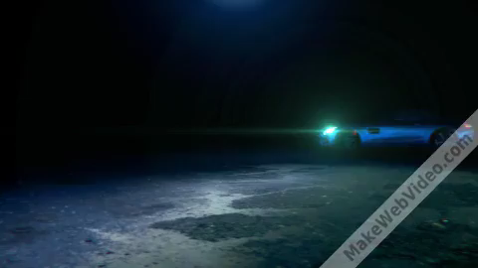
Model

Slide 21
Key Differentiators
Adoption Plan
Onboard
MaaS-Omni Channel marketers
Smart Infrastructure
Launch
Drive Value
Monitor Adoption
Further Engagement
Test Prototype with Early Adopters
Automobile Industry
Government
Marketing department of target companies
Measure and Report Usage
Data & Technology based, Location based decisions
Near-Real-Time
Artificial Intelligence supported
Azure Cloud Technology

Slide 22
Scalability & GitHub Link
The future may also be revolutionized by AI powered Autonomous Vehicles and flying cars.
There is a huge opportunity. The solution could be an integral part of the product.
Image-Location based Survey to Measure Visual Pollution and plan optimization strategy
GitHub Repository Link:
https://github.com/rahuldogranit/Digi-Artists

Slide 23
Sustainability impact
Plastic use, Billboards use Vinyl
Resources used for site construction & maintenance
Electricity Use (When not regulated)
Paper use, printing
Transportation use – Delivering the billboards to the sites
Solvent Toxins
Visual Pollution

Slide 24
Business Model and Deployment Plan
Month 1
Month 2
Month 3
Month 4
Month 5
Month 6
Embark overall plan
Identify pilot location
Partner with stakeholders
Data collection plan
Database set-up
Model development
Dashboard to visualise
- Azure set up
Development of final product
Testing and QC
Adoption
Identified and partnered with adplayer.pro – java code build complete

Slide 25

Thank You “Be a part of the solution, not the pollution”
Our heartfelt gratitute to the following members who ‘ll provide external support for our project:
Mohammed Aamid – Mechanical Design Expert & Technical Advisor
Vani Soni – 3D Designer

Slide 26
Backup Slide - Adverscience
It takes 250 milliseconds for the brain to absorb visual cues
Only 13 milliseconds for images to elicit emotion -- even if you aren't fully absorbing what you're seeing.
Aligning the creative to this and keeping the ad on for 2 seconds max will ensure that the driver is not distracted.

